Slide 1

Technological advancement revolutionizing safecare quality in health sector kenya ,2025.
By stella wanjala hudson shinali
Kmtc webuye ,kenya

Slide 2


Slide 3


Slide 4


Slide 5


Slide 6
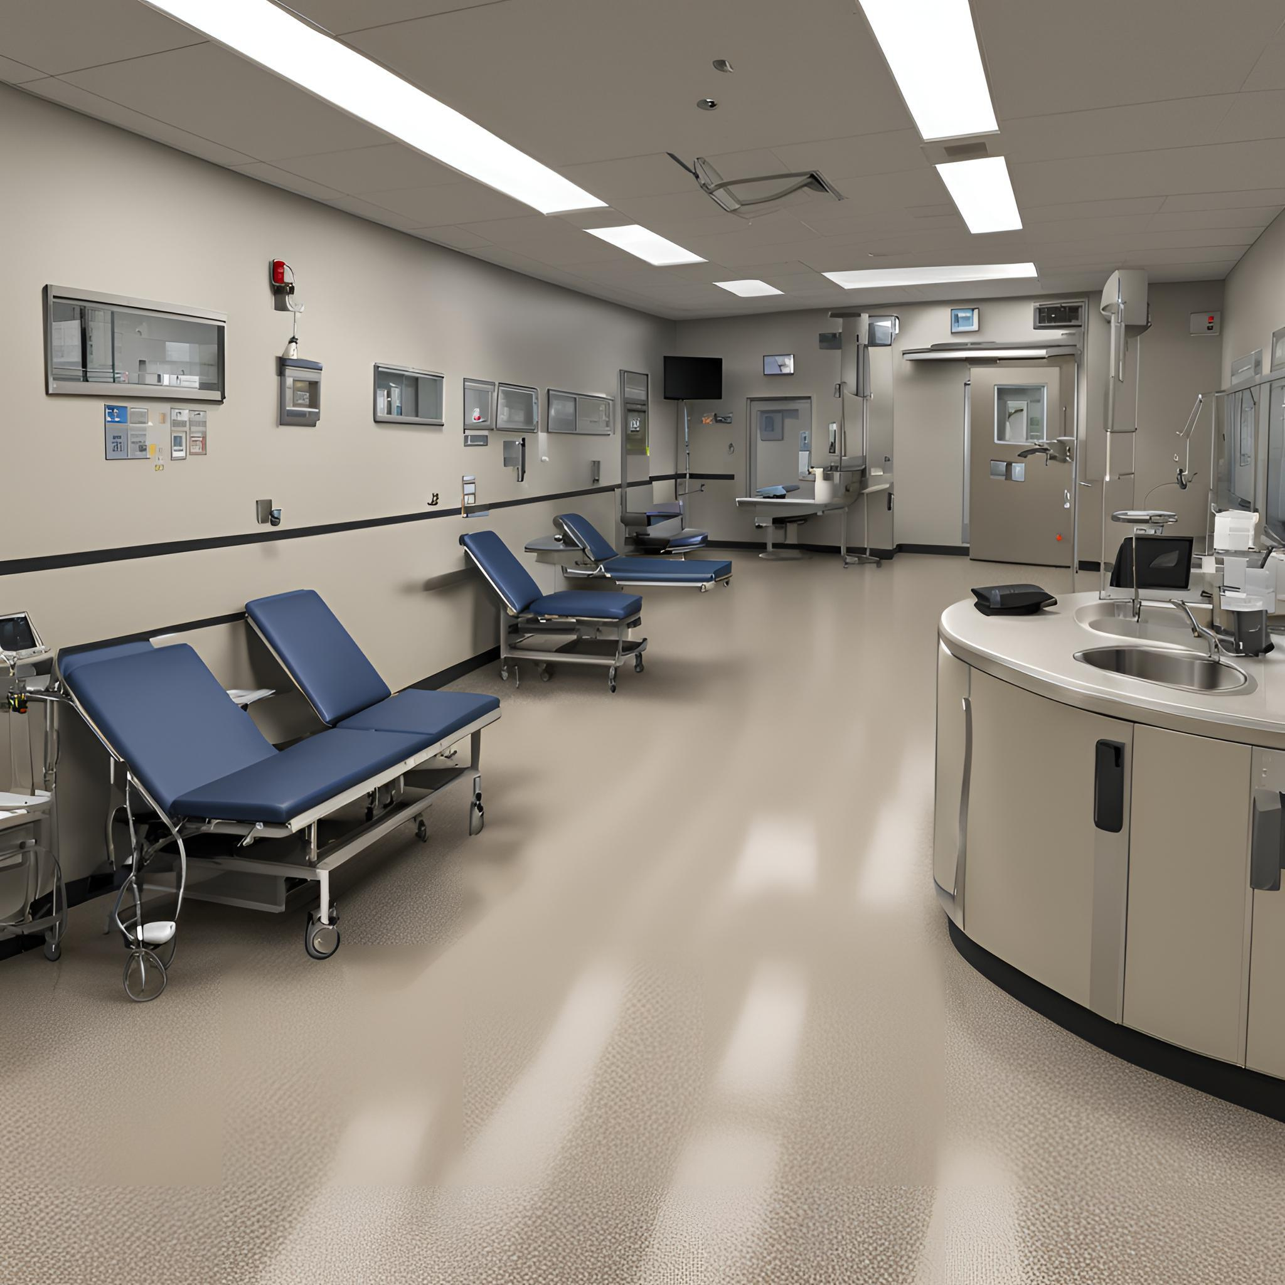

Slide 7


Slide 8


Slide 9


Slide 10


